Slide 1

CMR COLLEGE OF ENGINEERING & TECHNOLOGY
Kandlakoya, Medchal, Hyderabad - 501401
Department of Computer Science and Engineering
Depression Detection From Facial Expression Using Hybrid Model of FCN, Fusion Fuzzy Logic, and LSTM
Batch No: 20
Name of the students:
22H55A0505: CH.Bharath Kumar
21H51A0571: N.Sai
21H51A05M1: D.Hemavathi
Under esteemed guidance of
Major Dr.V.A.Narayana
Director CMRCET
Batch: 2021-2025 Major Project Phase 2

Slide 2
Outline
Abstract
Introduction
Problem Statement
Existing Solutions
Research Objective
Proposed System
Proposed Methodology
Dataset Specification
Model Architecture
Flow chart
Performance Metrics
Result and Output
Conclusion
References

Slide 3
Abstract

Slide 4
ABSTRACT
The system analyzes facial expressions in real time using Fully Connected Networks (FCNs), Long Short-Term Memory (LSTM), and Fusion Fuzzy Logic (FFL) to detect depression.
By focusing on key facial features, the model identifies subtle emotional cues associated with depression with high accuracy.
The use of the same dataset throughout ensures consistent training and evaluation for reliable performance.
Explainability tools are integrated to make the system's decision-making process transparent, aiding in its use for clinical mental health monitoring.

Slide 5
INTRODUCTION

Slide 6
Introduction
Depressive disorders are a leading cause of global disability, affecting over 300 million people.
Around 20% of the general population experiences depressive disorders at least once in their lifetime.
DSM-5 defines depressive disorders by symptoms like a sad, empty, or irritable mood, and cognitive and somatic changes that impair functioning.
Beck’s cognitive theory is widely accepted, emphasizing the role of thoughts and attitudes in the development of depression.
Primary symptoms include mood disturbances, cognitive alterations, and significant impacts on daily functioning.

Slide 7
Problem Statement

Slide 8
Problem Statement
Traditional depression diagnosis relies on subjective self-reports and clinical evaluations, highlighting the need for automated systems that can objectively and efficiently detect depression through facial expression analysis using computer vision and machine learning.

Slide 9
Existing solutions

Slide 10
Existing Solution-1
Automatic Identification of Depression Using Facial Images with Deep Convolutional Neural Network:
Developed a depression recognition method based on facial images and a deep convolutional neural network.
Based on 2-dimensional images, this method quantified the binary classification problem and distinguished patients with depression from healthy participants.
1020 pictures of depressed patients and 1100 pictures of healthy participants were used and divided into a training set, test set, and validation set at the ratio of 7: 2: 1.
Algorithms: Fully connected convolutional neural network (FCN), visual geometry group 11 (VGG11), visual geometry group 19 (VGG19), deep residual network 50 (ResNet50).

Slide 11
Existing Solution-2
Fusion Fuzzy Logic and Deep Learning for Depression Detection Using Facial Expressions:
Fusion Fuzzy Logic((FFL) with deep learning for identifying depressed people based on their facial expressions.
The primary goal of this research work was to use the fusion method to turn these facial expressions (FE) into the detection of depressed states.
To elevate the performance of the Fusion Fuzzy Logic((FFL) (fuzzy logic and CNN)), delivering them entreated them several times to imitate specific facial expressions.

Slide 12
Existing Solution-3
Explainable Depression Detection Based on Facial Expression Using LSTM on Attentional Intermediate Feature Fusion with Label Smoothing:
The model is based on LSTM with an attention mechanism.
It aims to combine those features using the intermediate fusion approach. The label smoothing was presented to further improve the model’s performance.
The experiment was conducted on 474 video samples collected at Chulalongkorn University.
The data set was divided into 134 depressed and 340 non-depressed categories.

Slide 13
Comparing Existing solutions
Title | Model/Algorithm | Depression Set | Healthy Set | Accuracy(%) | Precision(%) | Recall(%) | F1 score(%)
Automatic Identification using Facial Images with Deep CNN | FCN | 1020 | 1100 | 98.23 | 98.11 | 98.16 | 98.2
 | Vgg11 |  |  | 94.4 | 96.1 | 92.02 | 94.04
 | Vgg19 |  |  | 97.35 | 98.13 | 97.21 | 96.32
 | ResNet50 |  |  | 94.99 | 96.2 | 98.79 | 94.6
Fussion logic and depression using Facial Images with Deep CNN | Fuzzy logic and CNN | limiteddata set | limited data set | 94.3 | 95.1 | 91.4 | 93.1
Explainable depression detection basedon Facial Expression using LSTM | LSTM | 134 | 340 | 91.67 | 91.4 | 87.03 | 88.04

Slide 14
Research Objective

Slide 15
Research Objective
1.Data Collection:Gather a dataset of facial images or videos with labels indicating depression status.Ensure diverse demographic representation.
2.Data Preprocessing:Clean and normalize the data.Perform data augmentation to increase dataset variety.
3.Feature Extraction:Detect facial landmarks and relevant features.Extract emotion-related features.
4.Model Development:Select and train suitable machine learning models.Optimize model performance through hyperparameter tuning.
5.Model Evaluation:Evaluate the model using metrics like accuracy, precision, recall, and F1-score.
6.Implementation:Develop a user-friendly interface for uploading images or videos.Provide depression detection results with explanations.

Slide 16
Proposed System

Slide 17
Proposed System
Real-Time, Explainable Depression Detection System Using Facial Expressions with FCN-LSTM-Fuzzy Logic Architecture and Attention Mechanisms:
This system aims to detect depression in real-time by analyzing facial expressions using Fully Connected Networks (FCNs) for spatial feature extraction and Long Short-Term Memory (LSTM) networks for handling temporal dynamics.
The inclusion of an attention mechanism ensures that the model focuses on the most relevant facial features associated with depressive states.
By integrating explainability the system enhances transparency, allowing clinicians to understand the decision-making process.

Slide 18
Proposed Methodology

Slide 19
Proposed Methodology
1) Data preprocessing: Image resizing, normalization, and augmentation.
2) Feature extraction: FCN extracts relevant facial features.
3) Uncertainty handling: Fusion Fuzzy Logic refines decision-making.
4) Temporal dependency modeling: LSTM captures sequential patterns in facial expressions.
5) Classification: Final layer predicts depressive or non depressive states

Slide 20
Dataset Specification

Slide 21
Dataset Specification
The dataset ratio:
Training: 75%
validation and testing: 25%
The dataset comprises:
• Training set: 8926 depressed, 7215 not depressed images.
• Validation set: 1435 depressed, 1187 not depressed images.
• Test set: 1184 depressed, 887 not depressed images.

Slide 22
Model Architecture

Slide 23
Model Architecture
Our hybrid model consists of:
• FCN: Extracts deep facial features.
• Fusion Fuzzy Logic: Enhances decision-making by handling uncertainty.
• LSTM: Captures sequential dependencies in facial expressions.

Slide 24
Flowchart

Slide 25
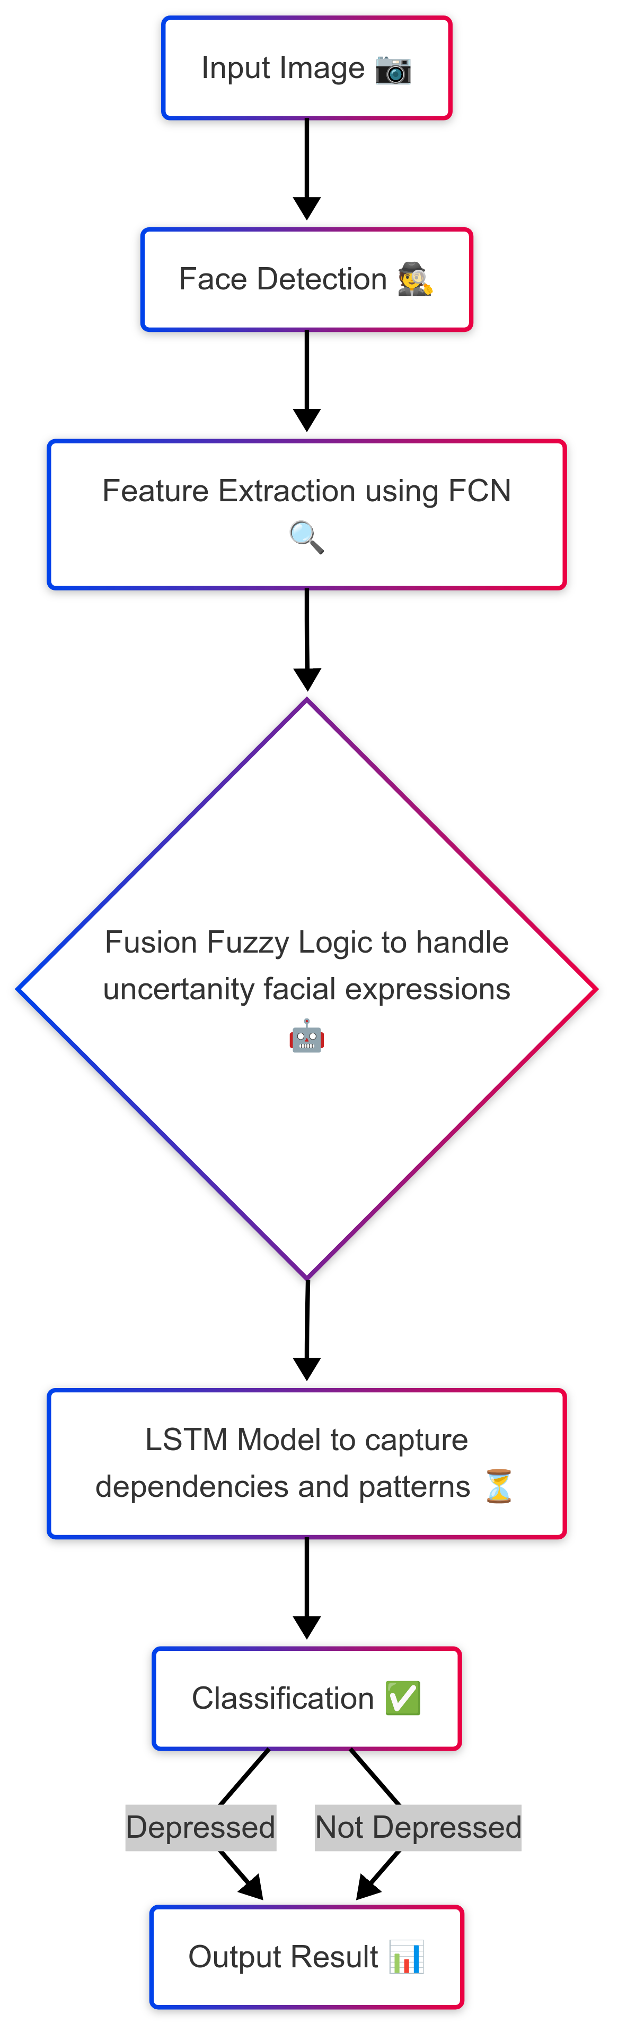
Flowchart

Slide 26
Performance Metrics

Slide 27
Performance Metrics of the Hybrid Model
Confusion Matrix:
[[1106 78]
[ 68 819]]
Accuracy: 92.95%
Precision: 93.41%
Recall: 94.20%
F1 Score: 93.80%

Slide 28
Deployment

Slide 29
Deployment of the Project
After training, the model is deployed using a web-based application:
• Frontend: Users upload an image for depression detection.
• Backend:The trained model processes the image and returns the classification result.
• Storage: Results and images are stored for future reference.

Slide 30
Result and Output

Slide 31
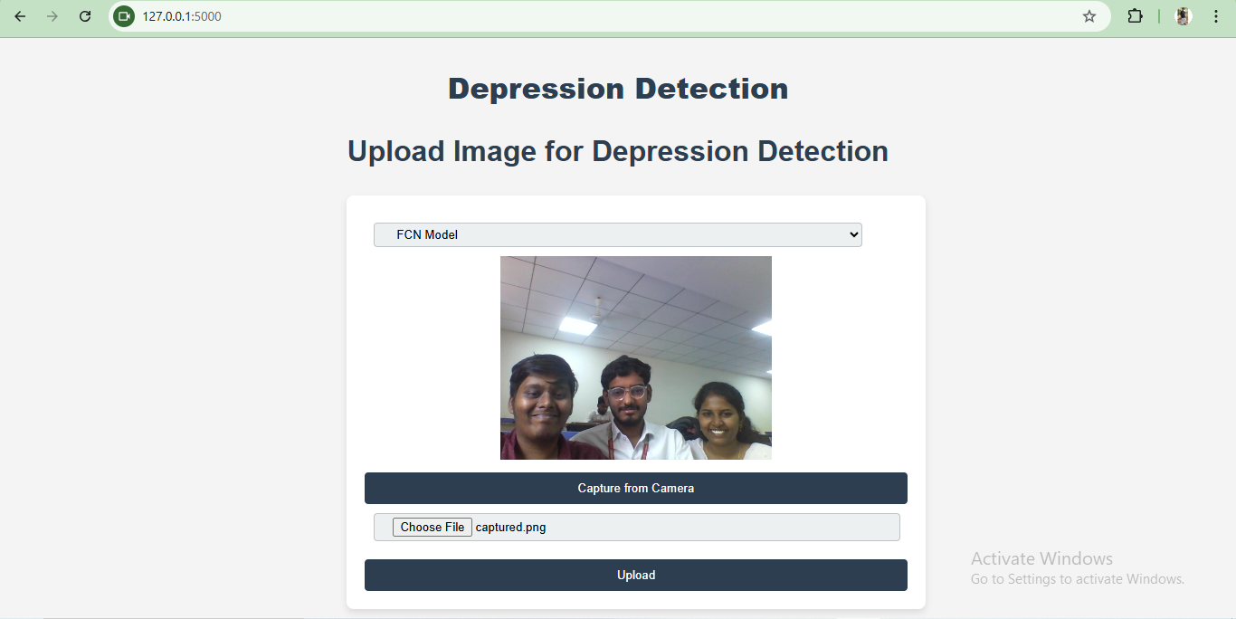

Slide 32
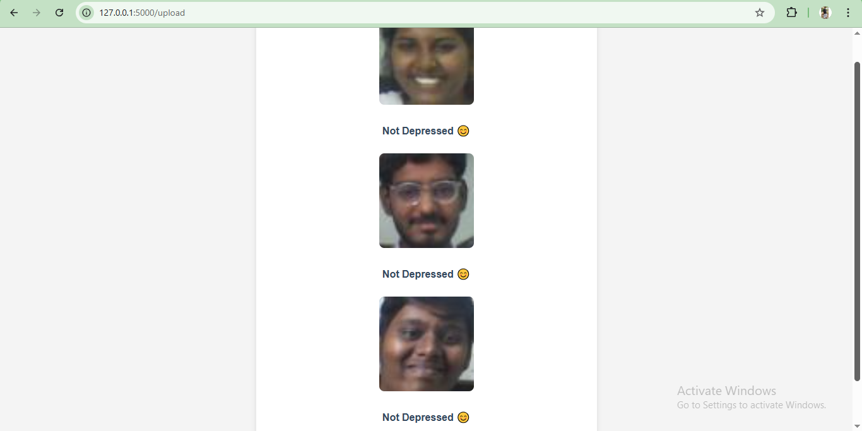

Slide 33
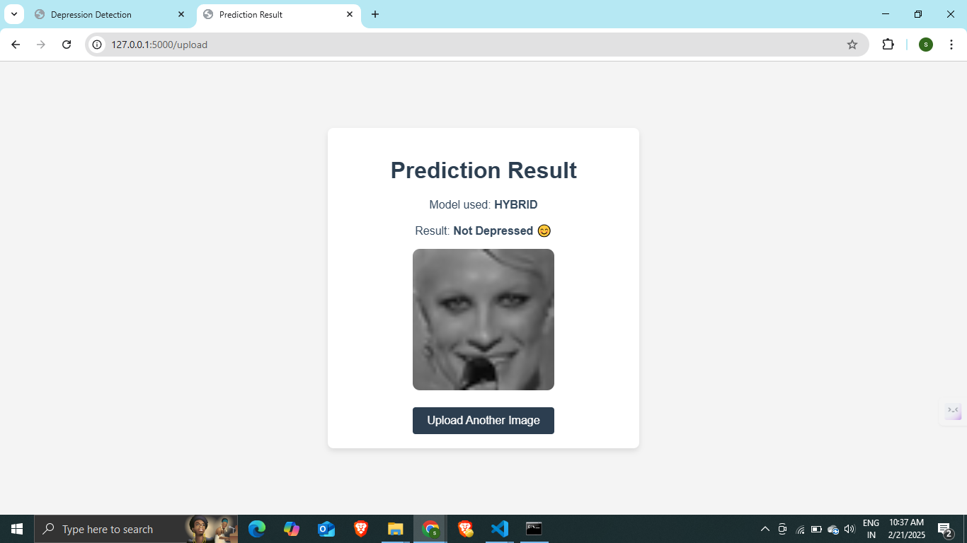

Slide 34
Conclusion

Slide 35
Conclusion
Our proposed hybrid model demonstrates promising results in detecting depression from facial expressions. By integrating FCN, Fusion Fuzzy Logic, and LSTM, we achieve improved accuracy and robustness compared to traditional methods. Future work will focus on expanding the dataset and optimizing model parameters for real-time applications.

Slide 36
REFERENCES

Slide 37
References
https://www.ncbi.nlm.nih.gov/pmc/articles/PMC9281460/
https://www.nature.com/articles/s41598-023-31277-5
https://link.springer.com/article/10.1007/s00521-024-09437-z#:~:text=In%20addition%2C%20Nixon%20et%20al,learning%20algorithms%2C%20Nazira%20et%20al.
https://www.mdpi.com/1424-8220/23/23/9402
https://www.sciencedirect.com/science/article/abs/pii/S0010482523009228

Slide 38
Thank You!

